Slide 1
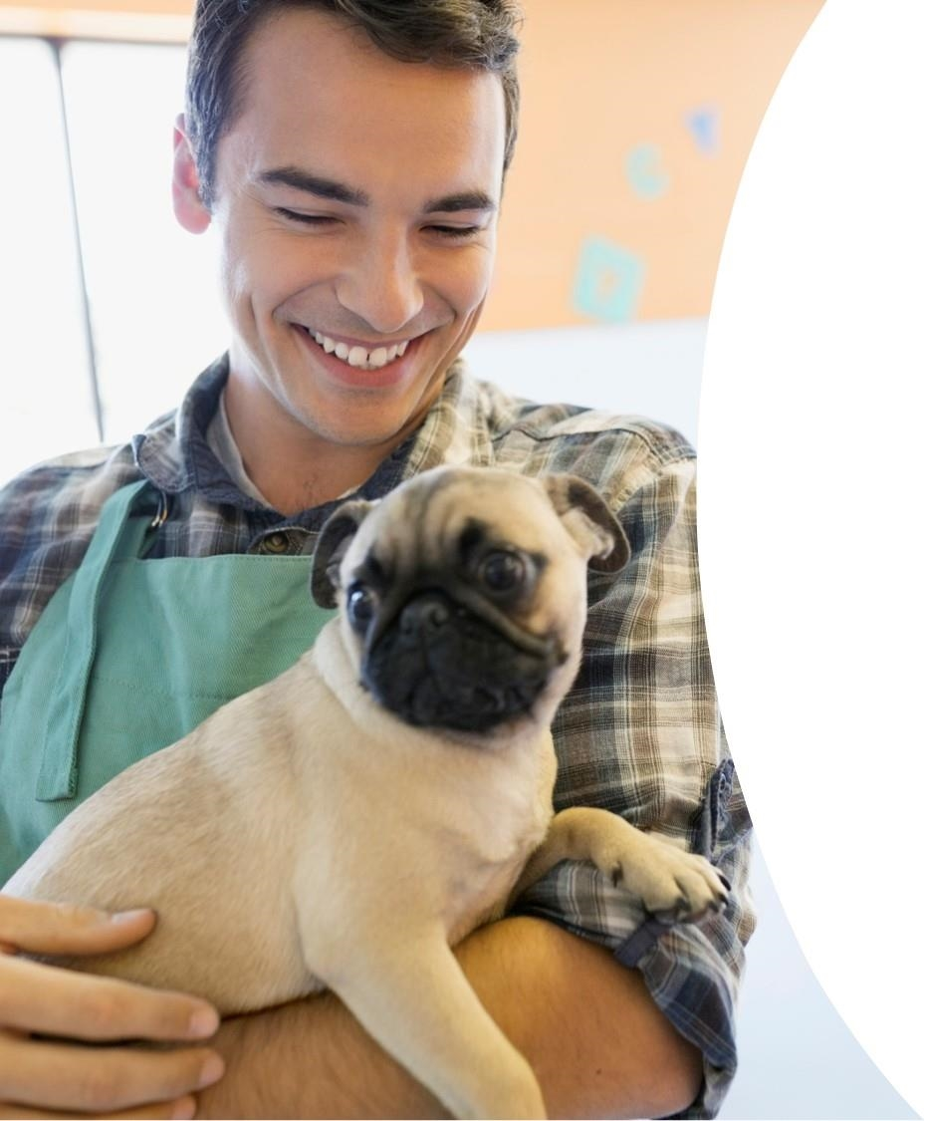
Starbucks Customer and Offer Marketing Analysis
Debbie Trinh
March 3, 2023

Slide 2
Introduction
Starbucks is a Business To Consumer Company that is the largest coffeehouse chain in the world. It offers specialty coffee, food items, handcrafted beverages, and merchandise.
The goal of this project is to understand the marketing attribution of the Starbucks rewards offer marketing strategy which drives user engagement / transactions to positively impact the bottom line.
Notes:
This is a Kaggle dataset: https://www.kaggle.com/datasets/blacktile/starbucks-app-customer-reward-program-data
Marketing attribution is how we determine how marketing tactics and user interactions contribute to sales. These metrics are used to identify channels and messages that inspire buyers to take action.
Link: https://advertising.amazon.com/library/guides/marketing-attribution
Link: https://www.globaldata.com/company-profile/starbucks-corp

Slide 3
Agenda
DEBBIE TRINH
PYTHON DATA ANALYSIS
WATERMARK
Understand the Customer: Descriptive Statistics
Number of Members / Aggregate Spend
Spending by Age Group using Sturges Rule
Spend Range / Number of Members Spent vs Not Spent
User Tenure Distribution
Influence of Reward Offers on User Behavior
Actions taken in Marketing Funnel
Customer Personas that reward offers appeal to
Effective Offer Types Variants / Gender that completes most offers
Channel Effectiveness
Reward Offer Response Rate
Recap of Insights / Marketing Strategy Actionable Recommendation
Next Steps to Improve Marketing Strategy via ML

Slide 4
Understand the Customer: Descriptive Statistics
DEBBIE TRINH
PYTHON DATA ANALYSIS
WATERMARK

Slide 5
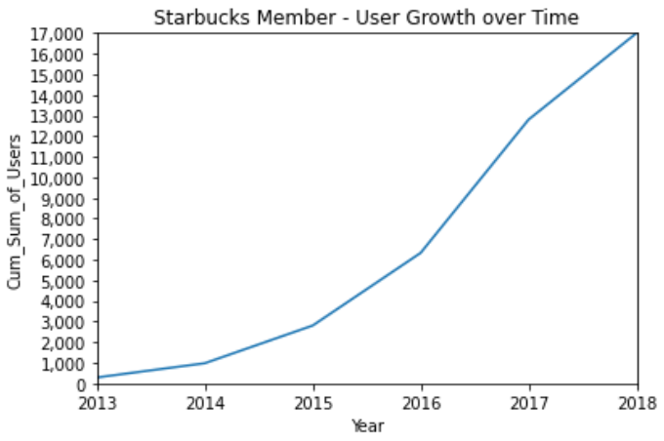
Understand the Customer: How many Starbucks members are in this dataset?
There are 17,000 users in this dataset.
The growth rate of Starbucks member user sign ups was exponential from 2013-2017, which demonstrates the popularity of this loyalty program.
Notes:
The rate that users have signed up to become Starbucks
Bubble plot
Hexabin
Marry eloquent visual to get to heart of dataset!
https://support.microsoft.com/en-us/office/add-a-watermark-to-your-slides-1246244d-f465-4e4f-b9f9-49acdae00ff1

Slide 6
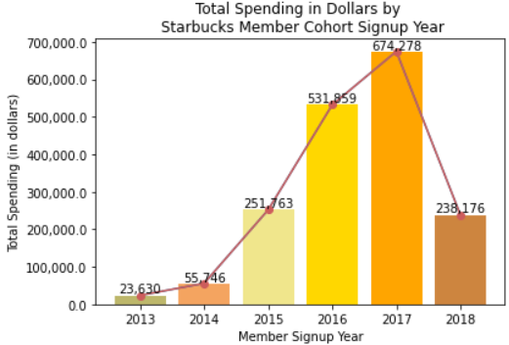
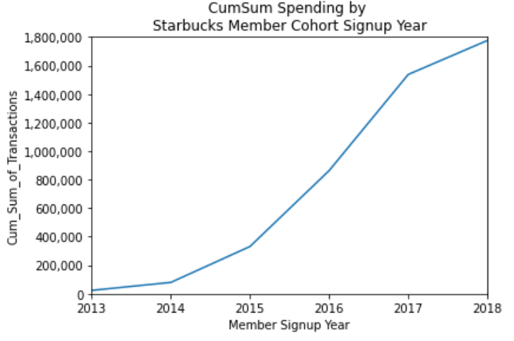
Understand the Customer: In aggregate, how much have these members spent in this dataset?
In aggregate, Starbucks members spent ~$1.78M.
With sharp increases in user sign ups between 2013 and 2017, total spending also follows that trend.
Notes:
The rate that users have signed up to become Starbucks
Bubble plot
Hexabin
Marry eloquent visual to get to heart of dataset!
https://support.microsoft.com/en-us/office/add-a-watermark-to-your-slides-1246244d-f465-4e4f-b9f9-49acdae00ff1

Slide 7
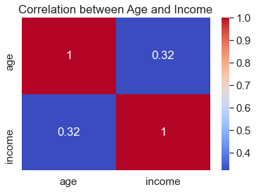
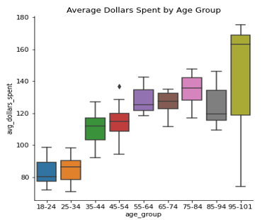
Understand the Customer: How much have these members spent at Starbucks by age group?
Customers spend more at Starbucks with age as income increases.
Notes:
For this business question, I filtered out users with imputed age = 118. Since these specific users omitted age, gender, or income, the omission would not help in inferring how much a user demographic spends.
Used heatmap
Link: https://www.sisense.com/blog/10-useful-ways-visualize-data-examples/

Slide 8
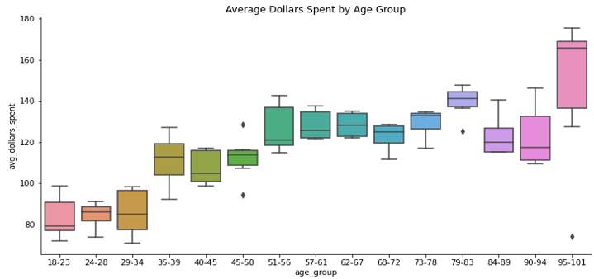
Understand the Customer: How much have these members spent at Starbucks by age group?
Using Sturges rule from Statistics to determine the optimal number of bins (log₂N + 1), 15 bins were prescribed.
Recommendation: Target age groups 35-50, 51-67, 68-83, 84-101 with reward offers that resonate with them in their stage of life to increase their propensity to spend because they command higher spending power.
Notes:
By using a customer segmentation strategy, we can approach age groups with different reward offer based on their average transactions over time.

Slide 9
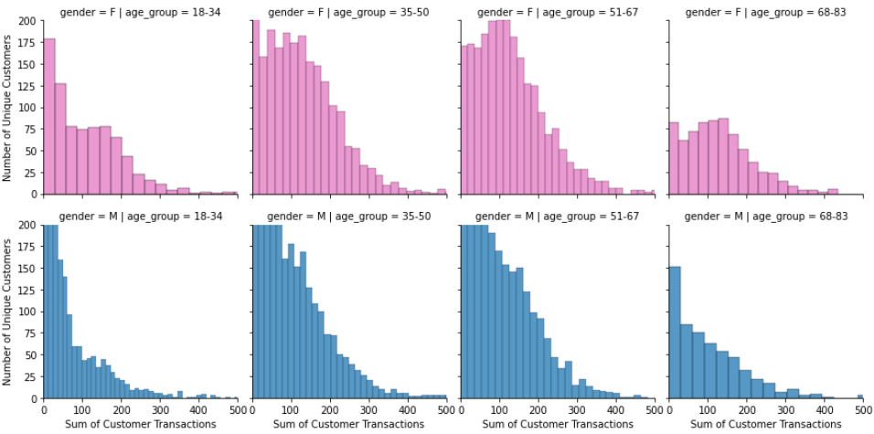
Understand the Customer: How do different customer segments spend at Starbucks?
Looking at customer segments with the largest volume of transactions,
Starbucks members who are female tend to spend more than males overall.
Notes:
Recommended chart: facet grid, multiple chart of the same nature, one part of customer base.
Ex. With age group and gender as cuts
Income vs. amount
https://seaborn.pydata.org/generated/seaborn.FacetGrid.html
Note:
Active members are defined by spending > $0 in the time range of this dataset.
Inactive members are defined as spending $0 in the time range of this dataset.

Slide 10
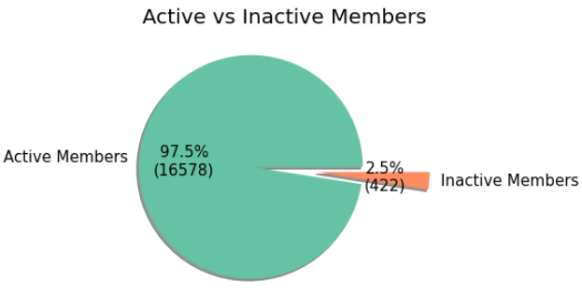
Understand the Customer: How many and what percentage of members have spent AND not spent this month?
Opportunity to activate 2.5% of inactive members if that is a priority.
One tactic: Offer a free good or pair a free good with a conditional action.
Notes:
LOOK FOR PAYING MEMBER NOTEBOOK
Recommended chart: facet grid, multiple chart of the same nature, one part of customer base.
Ex. With age group and gender as cuts
Income vs. amount
https://seaborn.pydata.org/generated/seaborn.FacetGrid.html
Note:
Active members are defined by spending > $0 in the time range of this dataset.
Inactive members are defined as spending $0 in the time range of this dataset.

Slide 11
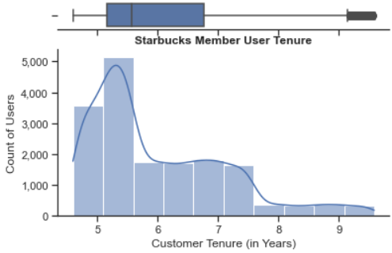
Understand the Customer: What is the distribution of User Tenure in this dataset (as of today)?
The average user tenure is 6 years, ranging between 4.5 and 9.5 years. This may be an important feature for customer segmentation.
Notes:
I created this feature. The mean is 6, min is 4.5, max is 9.5, with std of 1.1.
The user tenure is defined as when they signed up to the Starbucks rewards program, which is how they can digitally receive rewards offers.

Slide 12
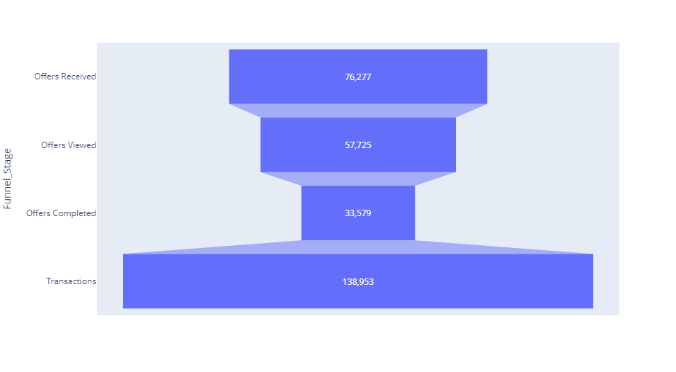
How many actions were taken in the marketing funnel in this dataset?

Slide 13
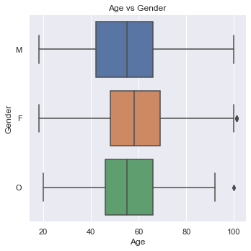
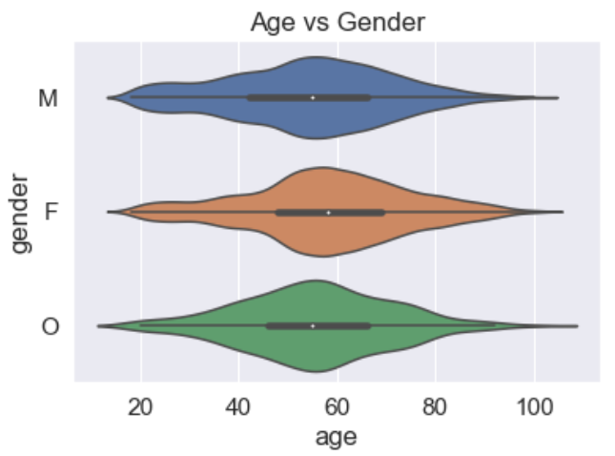
Which customer personas complete reward offers?
Notes:
I joined the dataset on events=‘offer completed’ to determine whether there was a specific customer niche that rewards offers appealed to.
Starbucks customers that completed a rewards offer were across the spectrum of age, location, and gender.
Try using violin plot to show normal distribution that it appeals to everyone.

Slide 14
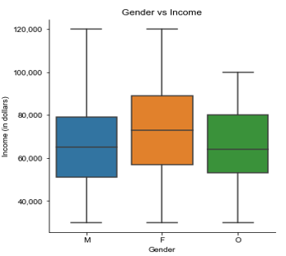
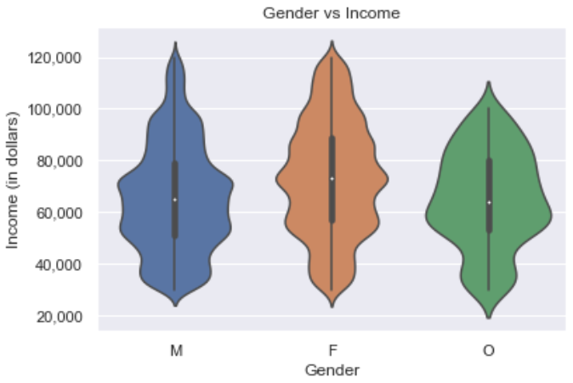
Which customer personas complete reward offers?
Notes:
I joined the dataset on events=‘offer completed’ to determine whether there was a specific customer niche that rewards offers appealed to.
Starbucks customers that completed a rewards offer were across the spectrum of age, location, and gender.

Slide 15
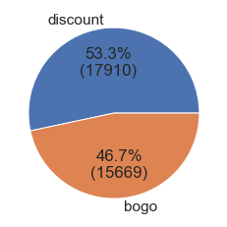
Of rewards offers completed, what kind of offer is it?
Discount offers perform relatively better than BOGO rewards offers.
What may explain this is customers don't need two things when they go to Starbucks.
Their motivation may be to go to buy one unique item while also experiencing Starbucks as a ‘Third Place’.
Notes:
The Third Place experience is "a warm and welcoming place, outside of our homes and our workspaces, where we connect and build community."
Link: https://stories.starbucks.com/press/2020/starbucks-ceo-the-third-place-needed-now-more-than-ever-before/

Slide 16
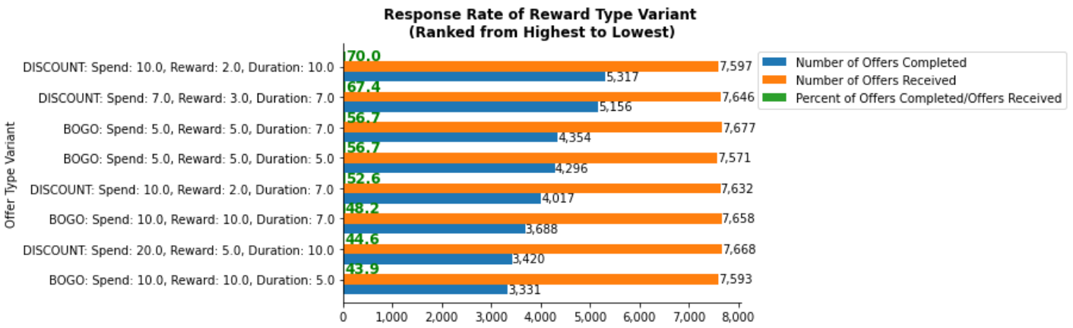
What are the top and bottom performing reward type variants?

Slide 17
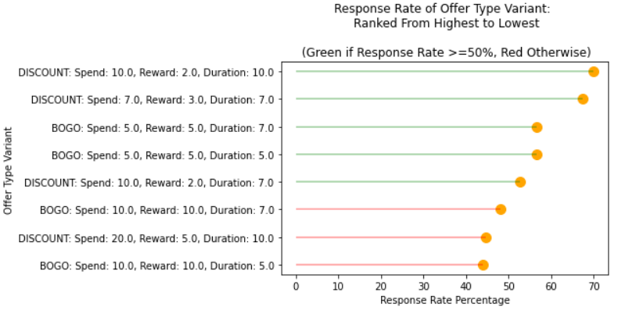
What are the top and bottom performing reward type variants?
A majority of the top 5 offer variants completed are discount reward offers.
The best performing BOGO offers are $5 difficulty and $5 reward.
The bottom 3 offer variants are $20 difficulty and $10 BOGO offers, probably because of their difficulty to complete and/or consumers not desiring a second item.

Slide 18
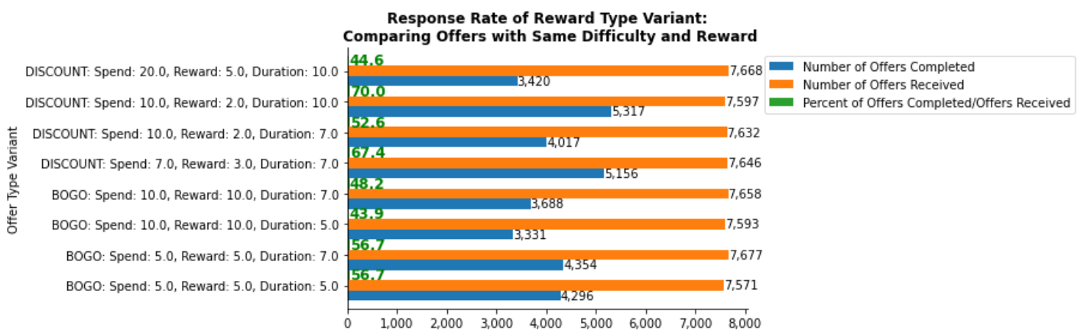
What may be contributing to offer type variant effectiveness?
Offers with the same difficulty and reward typically perform better with a longer offer duration.
This may be happening because the longer the offer is available, the likelihood the user has enough days to prioritize it while having urgency to act on it and complete the rewards offer.
Notes:
Must divide by total received.
Why this is business question is important is variants of an offer type may be more effective at offer completion.
Definition:
Difficulty is how much needs to be spent to receive the reward in $.
Reward is the reward value in $.
The Bogo offer difficulty and reward equal each other.
Offers with the same difficulty and reward performed better with a longer offer duration.
Why might this be the case?
This may be happening because the longer the offer is available, the likelihood the user has enough days to prioritize it while having urgency to act on it and complete the rewards offer.

Slide 19
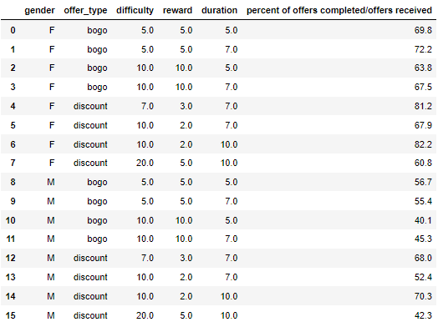
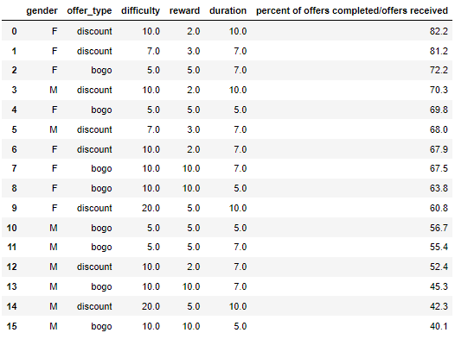
Which demographic completes the most offers and what type of reward offer variant appeals to them most?
The top 10 performing rewards offers are typically completed by females, have a 7-10 duration to complete, and are discount offers.
The best performing BOGO offer by gender is valued at $5.
The bottom performing offers by gender are $20 difficulty discount & $10 BOGO offers.
Notes:
I omit O because it's unclear what gender it is so would not inform future targeting strategy.
Top 10 are mostly female, discount offers, and 7-10 days long.

Slide 20
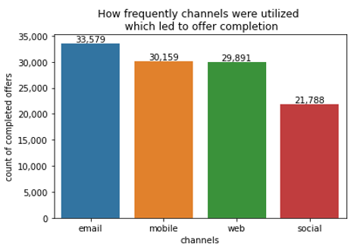
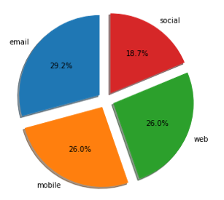
Which channels were used most frequently which led to offer completion?
Emails were used most frequently to complete offers,
followed by mobile & web, and then social.
Notes:
Emails were used most frequently to complete offers, followed by mobile & web, and then social.

Slide 21
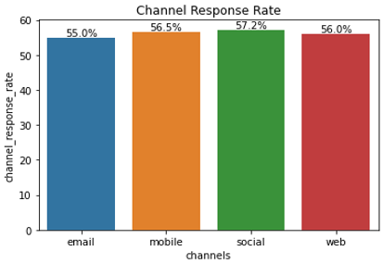
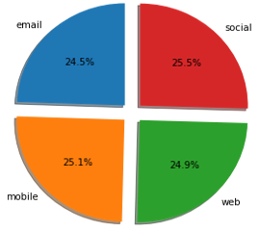
Which channel has been most effective in driving BOGO/Discount reward offers completion?
It’s essentially a tie.
Each channel has similar response rates from the user of 55-57%.
All channel strategies appear to be effective.
Notes:
Tik Tok, Instagram, Youtube Shorts have been effective for Starbucks social strategy.
Link: https://www.socialinsider.io/blog/starbucks-social-media-strategy/

Slide 22
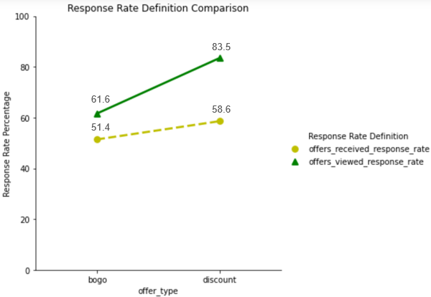
Direct Attribution: What is the rewards offer response rate?
Response rate is a behavioral metric to measure success of Starbucks reward offers strategy:
Direct Response Rate = Number of Offers Completed / Number of Offers Received
Direct Response Rate = Number of Offers Completed / Number of Offers Viewed
Notes:
TALKING POINTS: In the prior slides, I used Number of Offers Completed / Number of Offers Received to measure effectiveness of offer type variants and channel effectiveness to avoid biasing my dataset.
Something I have been considering to do in my next steps is to evaluate using Offers Completed / Number of Offers Viewed as a success metric instead
to see if it is something that is realistic in real world situations to drive user engagement for rewards programs even further.

Slide 23
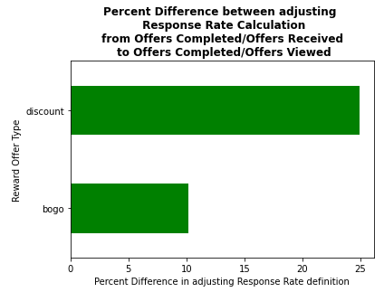
Direct Attribution: What is the rewards offer response rate?
If you can get customers to view the offer,
the response rate improves by 25% for discount offers & 10% for BOGO offers.
Bottom Line: Get users to be positively engaged in the long run!
Notes:
TALKING POINTS: If you can get users to view the offer,
For discount offers, the response rate jumps from 60% to 85%, a 25% difference!
For BOGO offers, the response rate jumps from 50% to 60%, a 10% difference!
Bottom line: it is important to get users to be positively engaged in the long run.
Be cognizant of spam or messaging fatigue that can detract from user engagement.
Note:
There are cases where offers are viewed and not completed, and a transaction is made.
Some users make transactions independent of using rewards they have seen, probably because they forgot, were in a hurry, or will redeem later.

Slide 24
Recap of Insights
DEBBIE TRINH
PYTHON DATA ANALYSIS
WATERMARK
The trend is customers spend more at Starbucks with age as income increases.
2.5% of members are inactive. A tactic to activate them is by offering a complimentary item that can be contingent on a user purchase action.
Offers with the same difficulty & reward performed better with a longer offer duration.
While email is the most frequently utilized channel, all channels (email, mobile, web, social) exhibit similar response rates from the user of 55-57%. Continue with current channel strategy as it is.
Discount offers perform relatively better than BOGO rewards offers. If you can motivate users to view the offer, the response rate improves by 25% for discount & 10% for BOGO offers.

Slide 25
Marketing Strategy Actionable Recommendations: Personas to Target & Strategy for Offer Type Variants
DEBBIE TRINH
PYTHON DATA ANALYSIS
WATERMARK
For future reward promotional strategy, target age groups 35-50, 51-67, 68-83, 84-101 because they tend to spend more at Starbucks than younger age groups. One suggestion is to tailor rewards that resonate with them in their stage of life to increase their propensity to spend.
Continue to target female consumers by promoting Starbucks Discount reward offers, with a 7-to-10-day duration to complete them.
Continue to promote the best performing BOGO offer by gender, which has a $5 difficulty and $5 reward.
Consider reducing or discontinue $20 difficulty discount offers and $10 BOGO offers, which does not as well relative to existing reward offers because of its difficulty to complete.
Notes:
Who should I target and what kind of reward type offer should I use?
For future reward offer promotional strategy, target age groups 35-50, 51-67, 68-83, 84-101 because they tend to spend more at Starbucks than younger age groups. One suggestion is to tailor rewards that resonate with them to increase their propensity to spend.
Provide more or create new discount rewards offers to female consumers, with a 7-to-10-day duration to complete them. The best performing BOGO offers are at a $5 difficulty and $5 reward so continue to promote that. Discontinue $20 difficulty rewards offers.
$20 appears to be too much to spend for the average consumer to be worth the reward.

Slide 26

What’s next?
Roadmap ahead

Slide 27
Next Steps / Future Work to Improve Marketing Strategy via ML
Further data analysis to determine total transactions to credit each reward offer type variant.
Do customer segmentation and clustering based on key features (Note: Customer segmentation can help suggest similar reward offers to users that haven’t seen that reward offer based on their cluster).
Create attribution rules for direct and indirect attribution to display as key metrics.
Create an R Shiny dashboard to display key metrics.
Feature engineer to enhance dashboard metrics, such as user tenure and average time to complete an offer.
Productionize model.
Notes:
Idea: Use geo-based visualization in R Shiny Project because Starbucks strategic priority is store expansion according to latest filings in SEC.

Slide 28
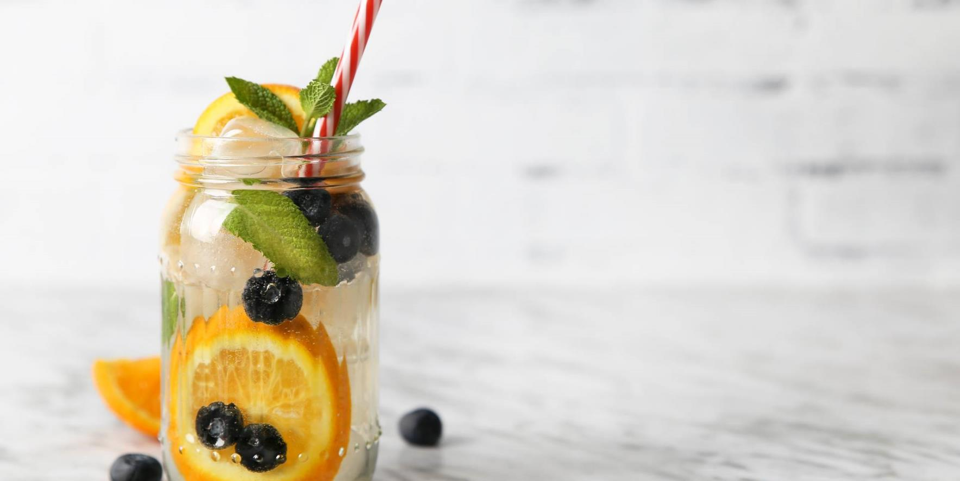
The way to get started is to quit talking and begin doing.
Walt Disney

Slide 29
Thank you
Python Libraries Used:
Pandas
Numpy
Matplotlib
Seaborn
Plotly
Sklearn
Datetime
Json
Debbie Trinh
https://www.linkedin.com/in/debbietrinh/
New York City Data Science Academy
January 2023 Cohort

